Slide 1
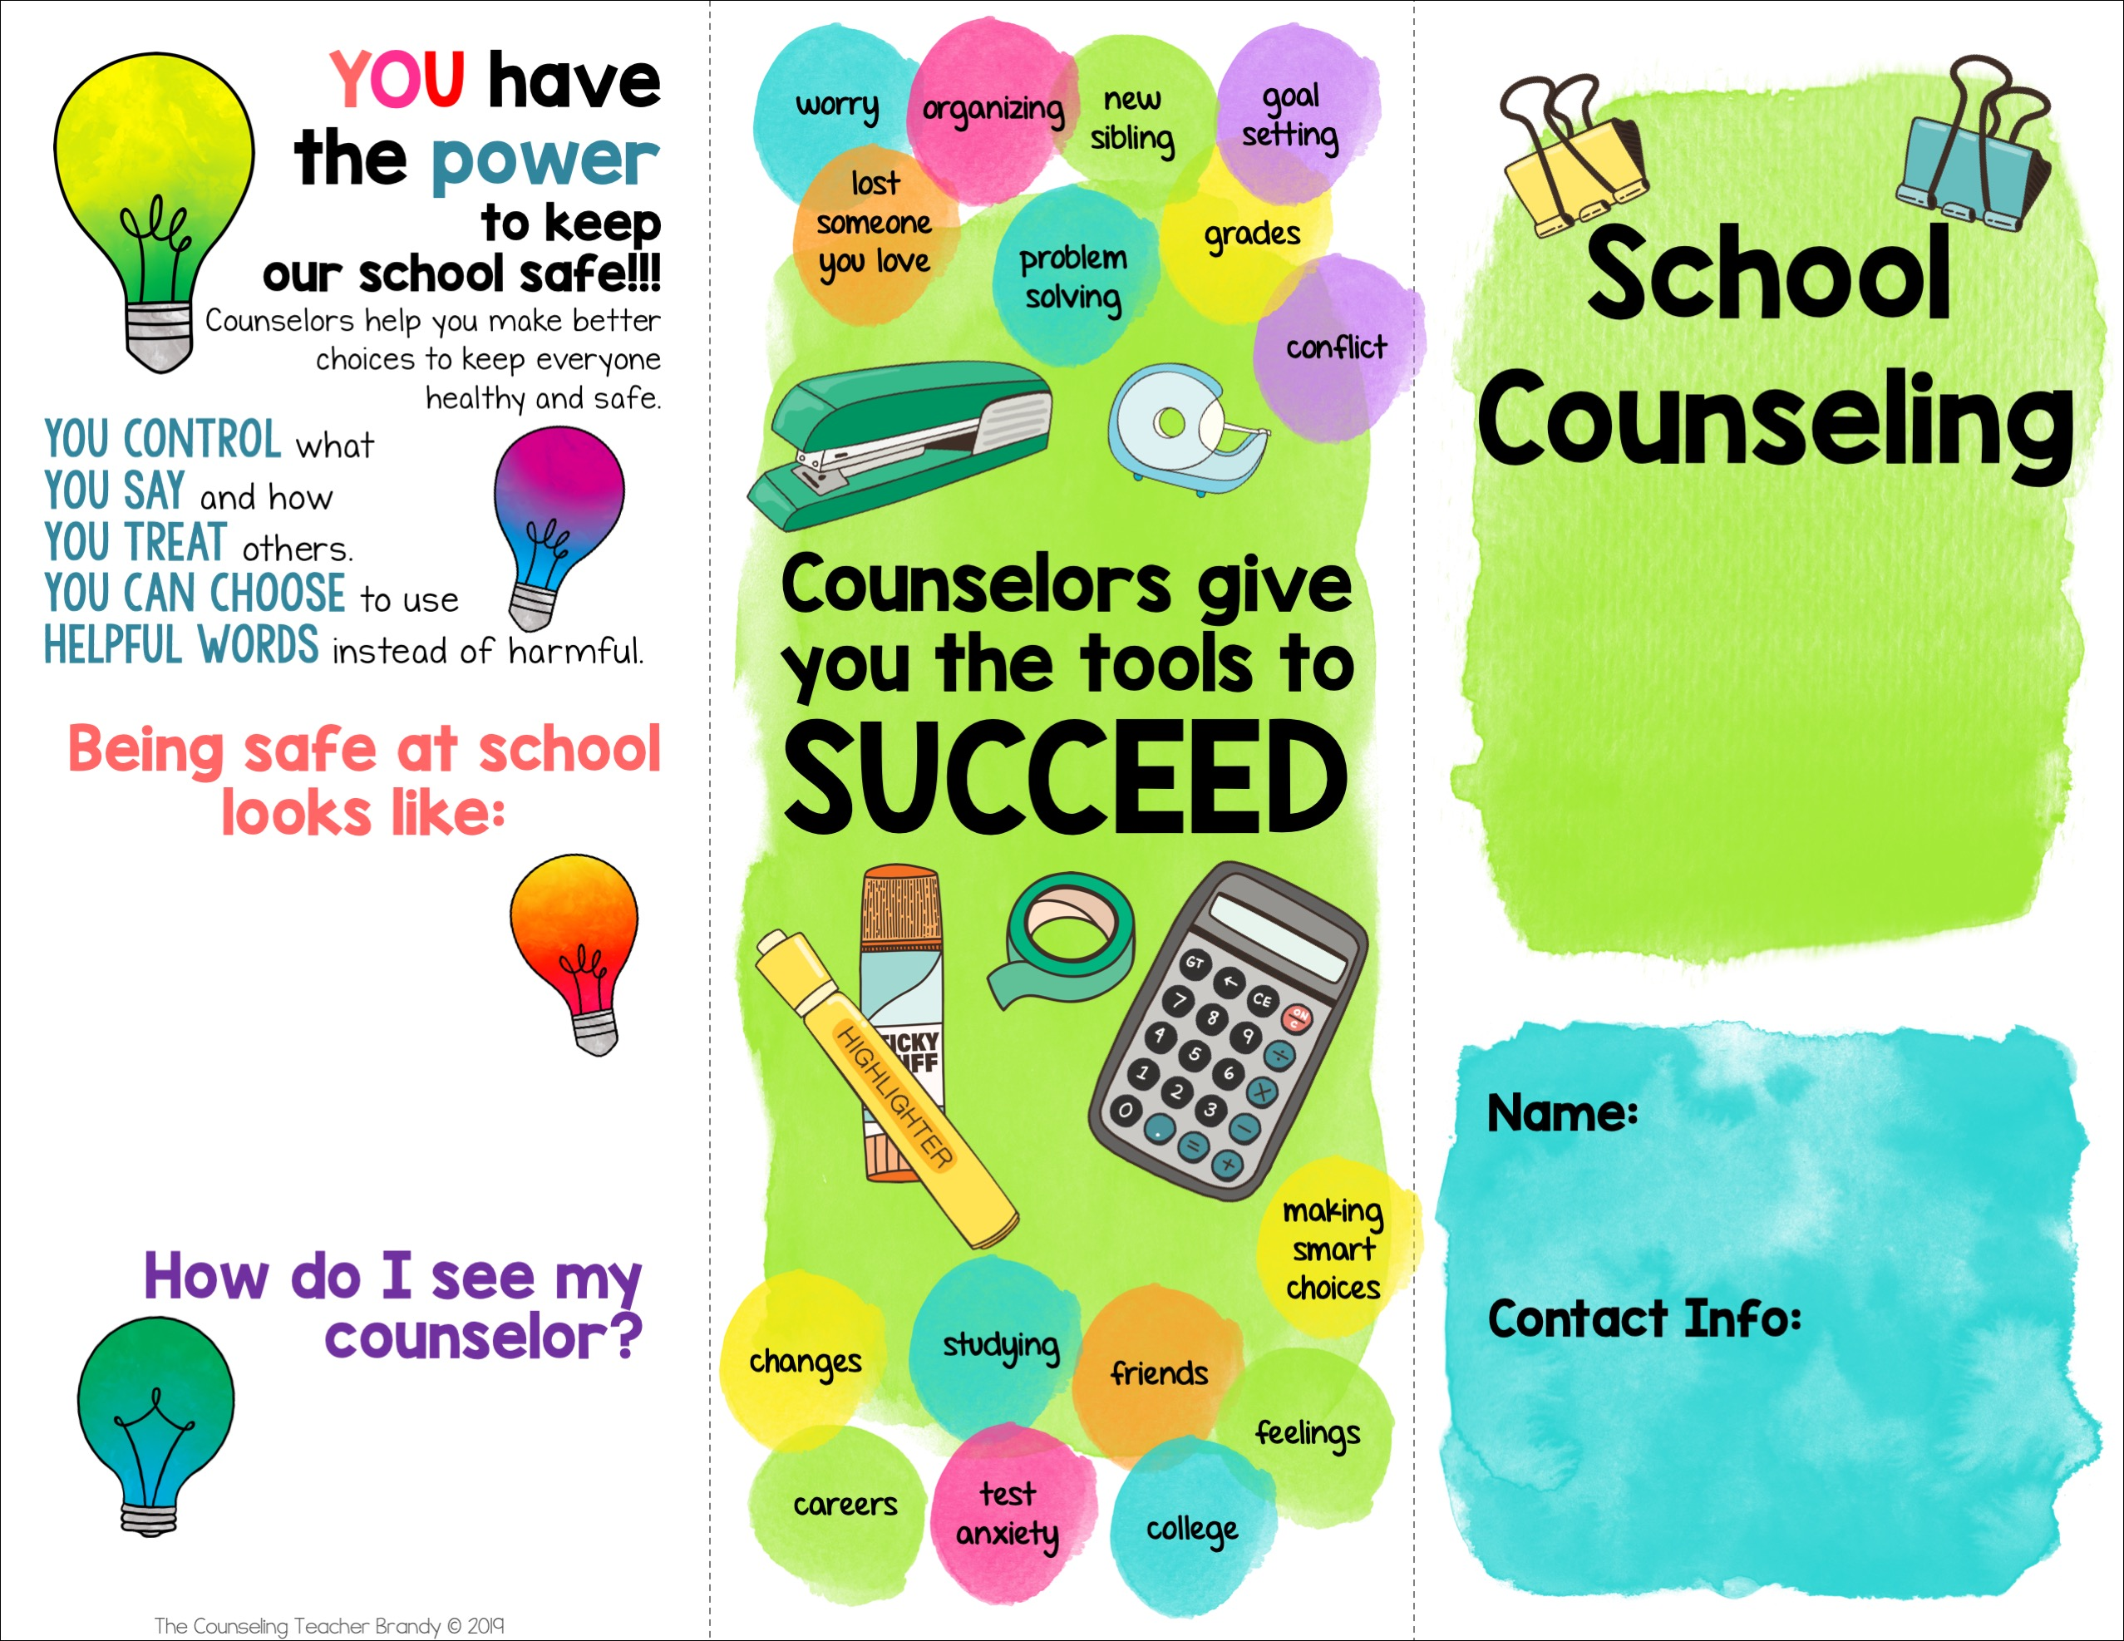
following rules
using kind words
telling adults when you need help
using calming tools if you feel upset
Mrs. Mauldin
mmauldin@macharter.org
(432)686-0003
Ask a teacher,
adult, or parent.
Fill out a request.

Slide 2
help you help yourself
guide you to find resources when you have a need at home or school
teach you how to cope with life and be your best self
help you stay safe
care
Once a month in classroom lessons
During small groups & lunch bunch
In individual sessions by appointment
worried about something (school, family, work)
want help making choices or solving a problem
having trouble with another kid or adult
need help focusing in class
confused about something
big changes in your life
concerned about something you heard at school or home
saw somebody getting hurt
somebody is hurting you
you feel like hurting yourself or others
judge you
punish you

